Slide 1
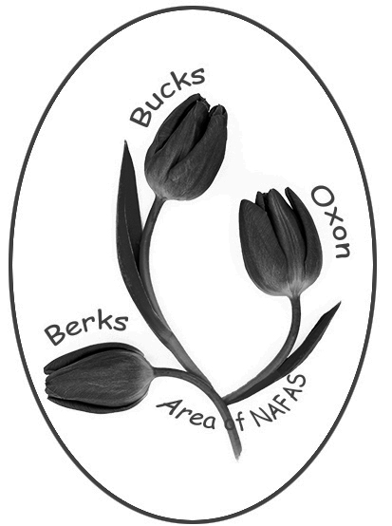
Berks Bucks and Oxon Flowers
Standard format for area heading is as above:
Capitalised case - no commas
Font Comic Sans MS in colour #922262 (146/34/98)
Alternative abbreviation is BB&O Area of NAFAS
If a border is added it should be colour #922262 (146/34/98)
PNG files of Area and NAFAS logos with a transparent background are available under the Area Standards and Logos section of the website. These files are ideal for embedding into publicity material as they take on the background of the main file. To use the files:
Right click on the image
Save As ..
Then Insert the saved file into the required publicity material
Alternatively for use in letterheads on white background right click on any of these images and copy/paste into your document.
When users scan this QR code on a smart phone it will take them directly to home page bbandoflowers.org.uk.
To use this: Right click, copy and paste code into publicity material.
This file is held under Admin/Area Standards and Logos section of the area website at bbandoflowers.org.uk

